Slide 1
Predicting Housing Prices using Advanced Regression Techniques

Slide 2
Introduction
Ask a home buyer to describe their dream house, and they probably won’t begin with the height of the basement ceiling or the proximity to an east-west railroad. But this dataset proves that much more influences price negotiations than the number of bedrooms or a white-picket fence. The goal of this project is to use EDA, visualization, data cleaning, preprocessing, and linear models to predict home prices given the 79 features, describing (almost) every aspect of residential homes in Ames, Iowa, and interpret linear models to find out what features add value to a home.

Slide 3
Dataset description
The data was originally taken from Kaggle. (https://www.kaggle.com/c/house-prices-advanced-regression-techniques#description). As stated on the Kaggle competition description page, the data for this project was compiled by Dean De Cock of Truman State University for educational purposes, and it includes 79 predictor variables (house attributes) and one target variable (sale price). Data set describes the sale of individual residential property in Ames, Iowa from 2006 to 2010.

Slide 4
Exploratory Data Analysis
Better sense of the data allows us to go through and do some analysis on the data. Variables dealing with the actual dimensions of the house have a large impact on Sale Price. There are also features that do not have a strong relationship with Sale Price, such as ‘Year Sold’. However, a few variables, like overall quality and lot square footage are highly correlated with Sale Price. We can also see it from the plot below.

Slide 5
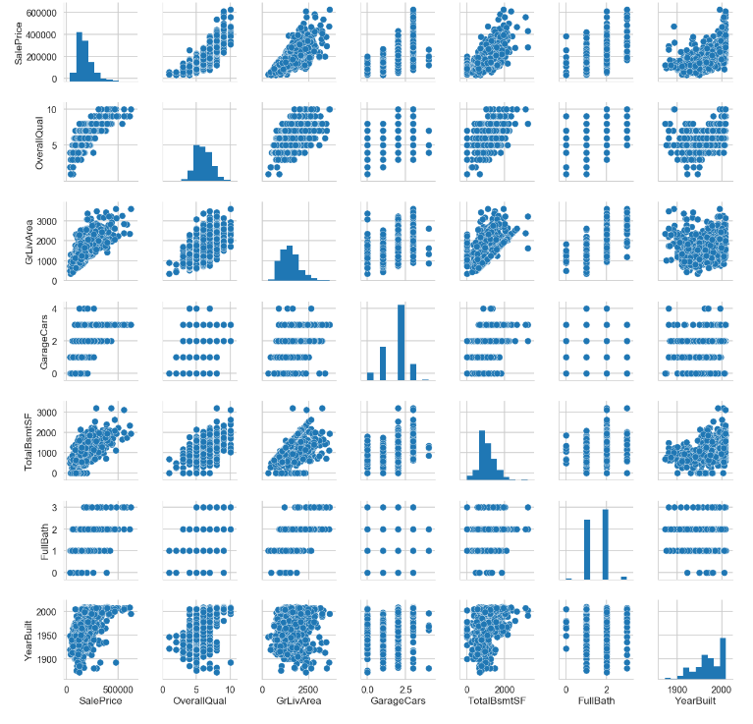

Slide 6
Pre-processing the data
Before run models on the data, I had to transform many of the variables. The following pre-processing steps were taken:
Removing outliers
Dealing with missing values
Created dummy variables for the categorical variables
Split the data into a training set and a test set
Scaled the data

Slide 7
Models
The information in the table represents best results for each model that was used for Sale Price prediction on test data (the lower is RMSE, the better the model predicts). Probably, various linear models perform better than Random Forest model. This had a lot to do with the data itself, Sale Price likely has a relatively linear relationship with the predictor variables.
 | ElasticNetCV | RidgeCV | LassoCV | RandomForest | Xgboost
RMSE | 0.105 | 0.112 | 0.107 | 0.303 | 0.133

Slide 8
The following features have the strongest impact on Sale Price predictions: above grade (ground) living area in square feet, lot size in square feet, total square feet of basement area, overall material and finish quality, overall condition rating, size of garage in square feet, remodel date, original construction date, unfinished square feet of basement area, year garage was built.

Slide 9
Conclusions and recommendations
The objective of this project was to build models to predict housing prices of different residences in Ames, Iowa. Our best model resulted in an RMSE of 0.105, which translates to an error of about $9000 (or about 5%) for the average-priced house. The variables seen as most important or as strongest predictors through our models were those related to square footage, the age and condition of the home, the neighborhood where the house was located.

